Slide 1
Appium UI Test On Android
Maby 2017/05/04

Slide 2
Agenda
Appium
Python Unittest Framework
UIAUTOMATORVIEWER
Script
Demo

Slide 3
Appium
Philosophy
You shouldn’t have to recompile your app
You shouldn’t be locked into a specific language
Shouldn’t reinvent the wheel when it comes to automation APIs
Open Source
Do things like a real user

Slide 4
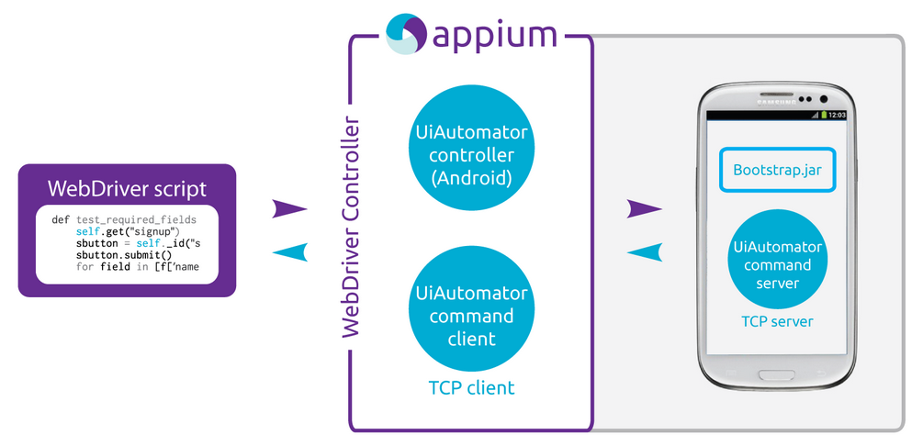
Appium

Slide 5
Demo
Appium GUI

Slide 6
Python Unit Test
import unittest
class ThermosTestCase(unittest.TestCase):
def setUp(self):
#Set up environment
def tearDown(self):
#After each test case completed
def test_XXX(self):
#Test case
if __name__ == '__main__':
unittest.main()

Slide 7
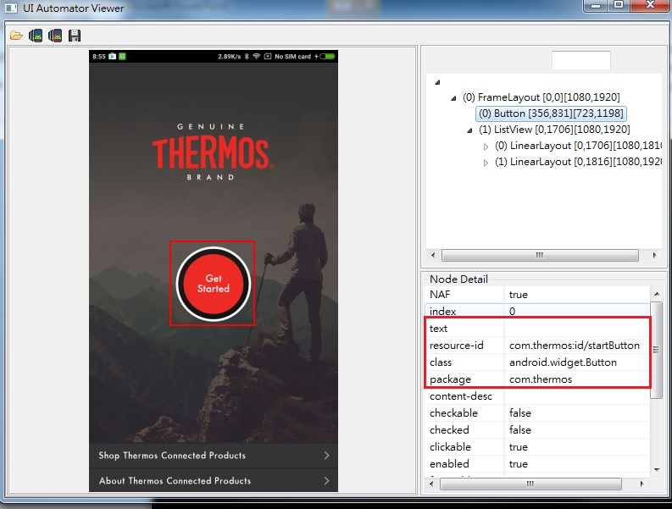
UIAUTOMATORVIEWER

Slide 8
Demo
UIAUTOMATORVIEWER

Slide 9
script
Click
self.driver.find_element_by_id('com.thermos:id/startButton').click()
Input
MailAddress = "AppiumTest@test.com" InputField_Mail = "com.thermos:id/edit_email" self.driver.find_element_by_id(InputField_Mail).send_keys(MailAddress)
Screenshot
adb –s deviceName shell screencap –p /pathYouWantToSave/

Slide 10
Demo
Demo the script on real device

Slide 11
References
Appium Documents
https://github.com/appium/appium/blob/master/docs/cn/about-appium/intro.cn.md
https://anikikun.gitbooks.io/appium-girls-tutorial/content/introduce_appium.html
http://toolsqa.com/mobile-automation/appium/appium-tutorial/
Python Unittest
https://docs.python.org/3/library/unittest.html

